Slide 1
data
Collecting and Displaying Data

Slide 2
answer the following questions:
Use the data collected to help you answer the following and to analyze flight delays:
1
Which airports experience the most delays in departures or arrivals?
2
Which cities or states experience the most delays?
3
Which airlines have the highest delay rates?
4
Are delays more closely associated with a specific type of delay (air system, etc.)?

Slide 3
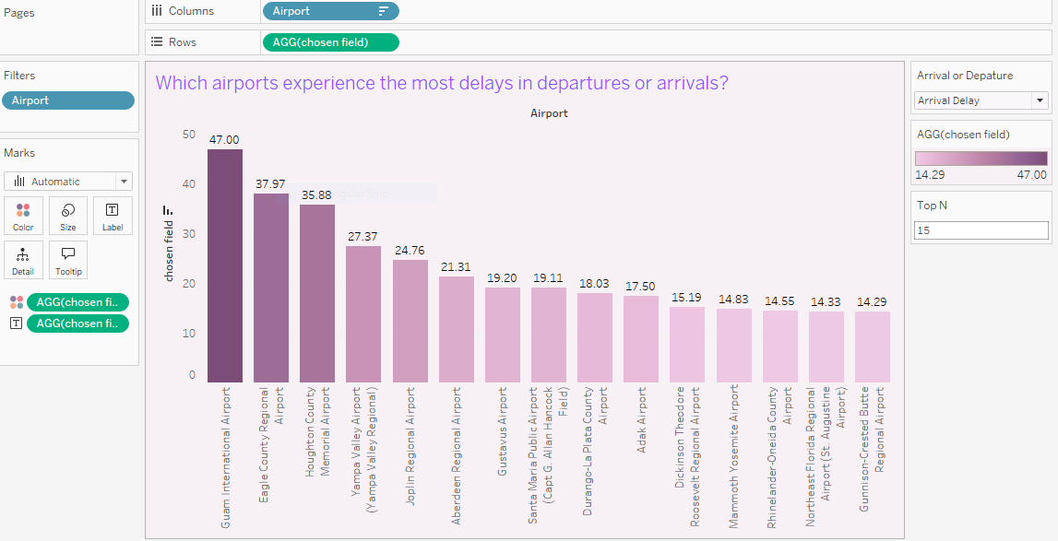
Which airports experience the most delays in departures or arrivals?
Steps:
Create parameter to choose arrival or departure delay
Create a calculated field when you click on it choose to arrive or departure delay
Create parameter to choose top n
Show relationship

Slide 4
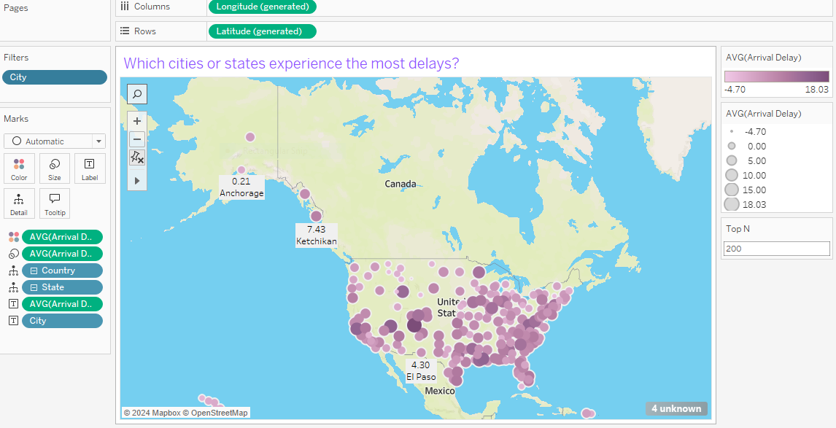
Which cities or states experience the most delays?
Steps:
Create country and state hierarchies and set latitude and longitude to make a map

Slide 5
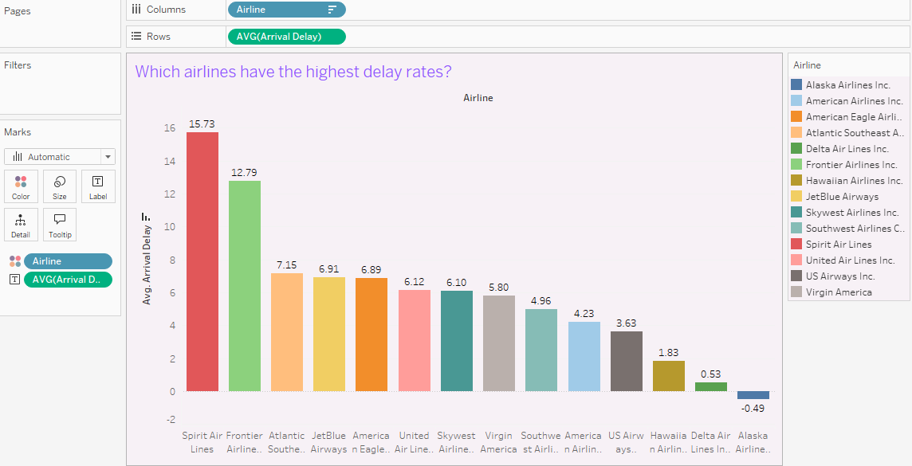
Which airlines have the highest delay rates?
Steps:
Relationship between Airline and Arrival delay

Slide 6
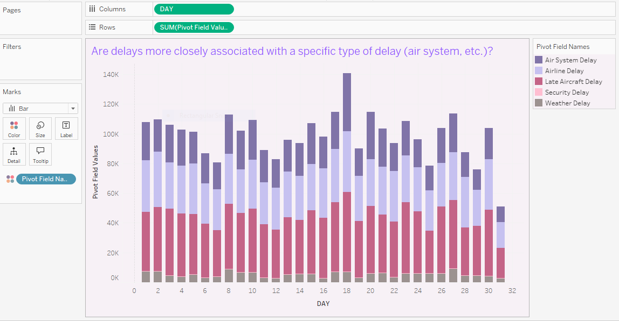
Are delays more closely associated with a specific type of delay (air system, etc.)?
Steps:
Create one column contains the reasons for the delay in order to show the reasons for the delay in this day

Slide 7
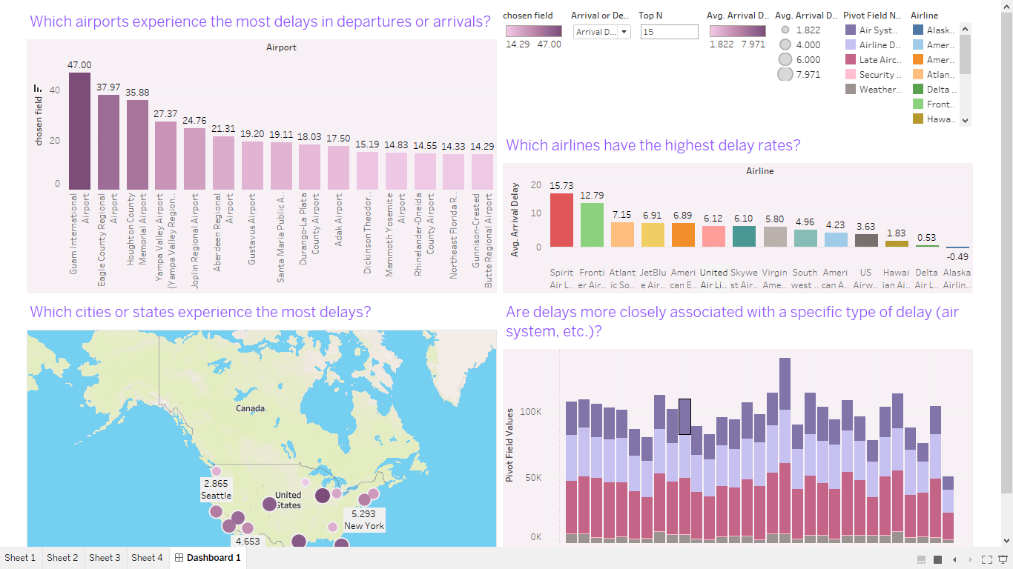
DashBoard

Slide 8
answer the following questions:
Use the data collected to help you answer the following and to analyze airports:
1
What is the relationship between airlines and flight cancellation rates?
2
Which airlines operate in the most airports ?
3
Airline on-time performance within a window of 10 minutes delay to 10 minutes early departure.

Slide 9
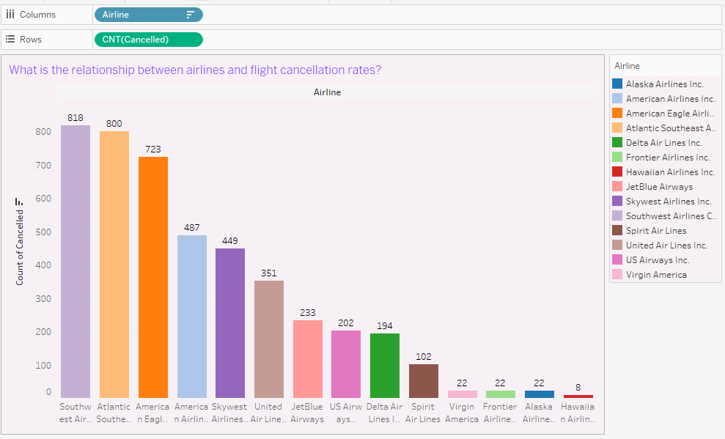
What is the relationship between airlines and flight cancellation rates?
Steps:
Calculate the number of flights cancelled per airline

Slide 10
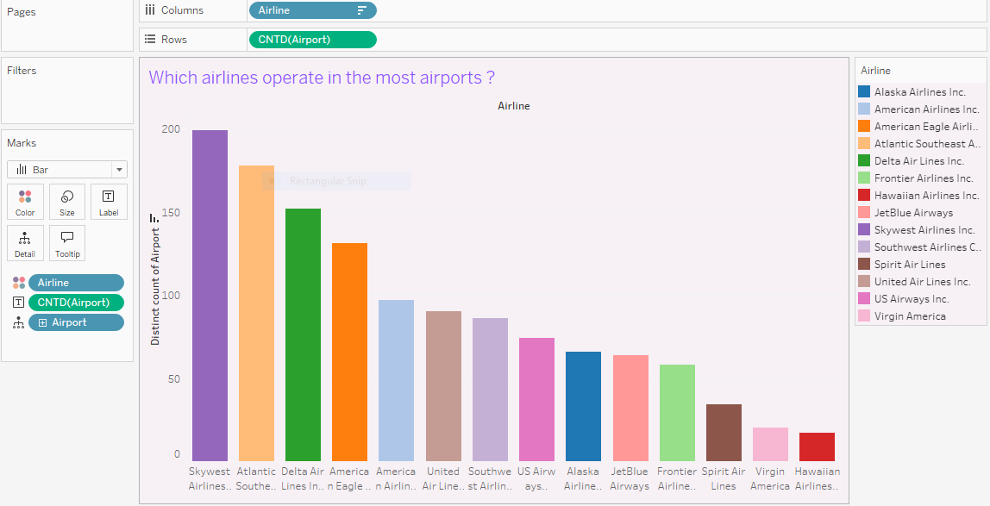
Which airlines operate in the most airports ?
Steps:
Calculate the number of airports in each airline

Slide 11
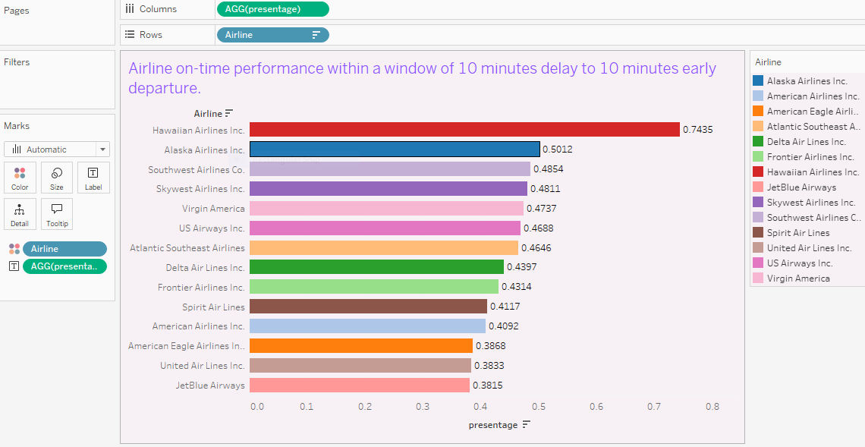
Airline on-time performance within a window of 10 minutes delay to 10 minutes early departure.
Steps:
Create calculated field to compute if less or greater than 10
Create a calculated field to compute presentage with sum prev calculated fild and diveded by count number arrival delay

Slide 12
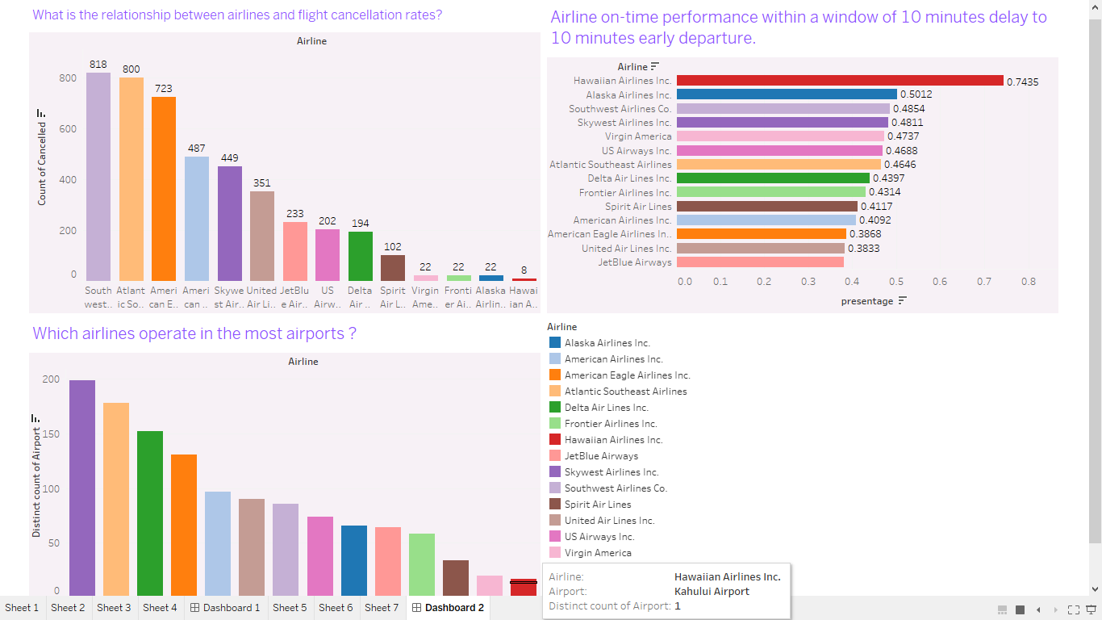
DashBoard

Slide 13
answer the following questions:
Use the data collected to help you answer the following and to analyze airport performance:
1
The most airports that open flights?
2
What is the average taxi time (TAXI_OUT and TAXI_IN) for each airport?

Slide 14
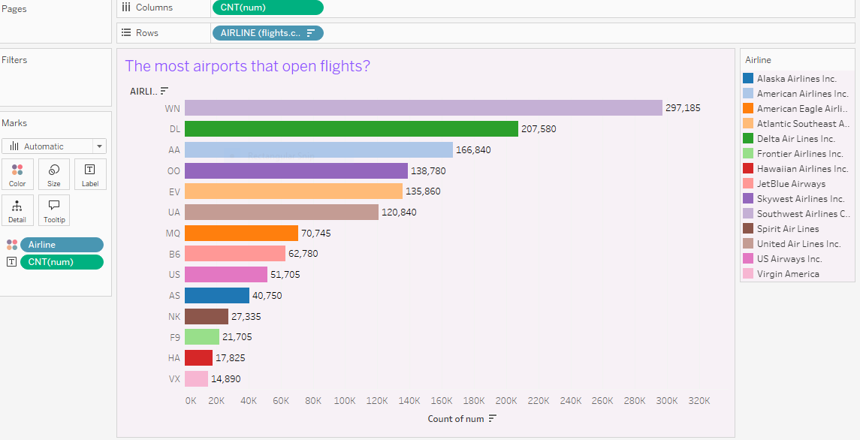
The most airports that open flights?
Steps:
Create a new column that all contains one
Calculate the number of ones per trip

Slide 15
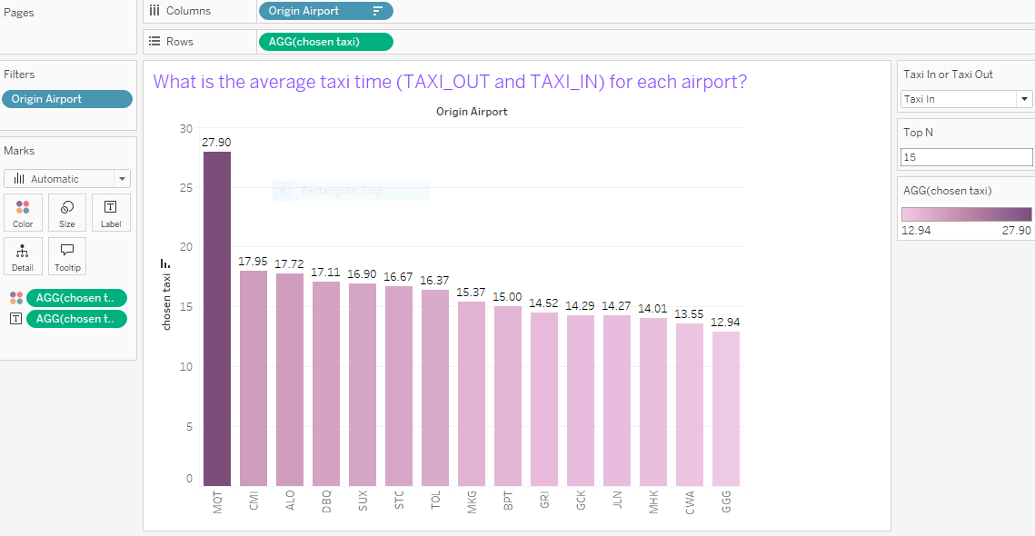
What is the average taxi time (TAXI_OUT and TAXI_IN) for each airport?
Steps:
Create parameter to choose taxi in or taxi out
Create a calculated field when you click on it choose avg. to taxi in or taxi out
Create parameter to choose top n
Show relationship

Slide 16
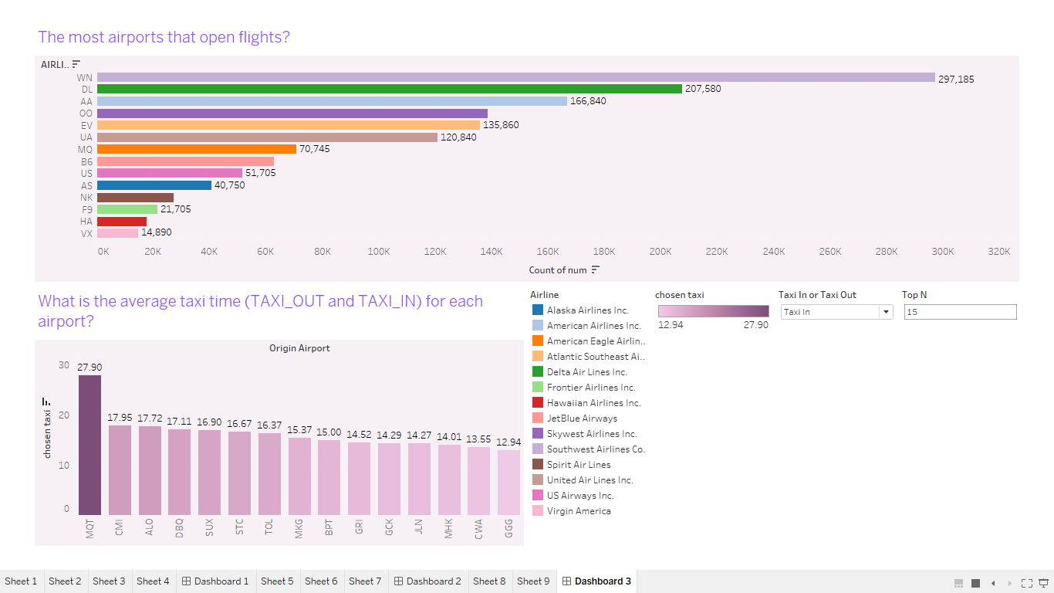
DashBoard

Slide 17

answer the following questions:
Use the data collected to help you answer the following:

Slide 18
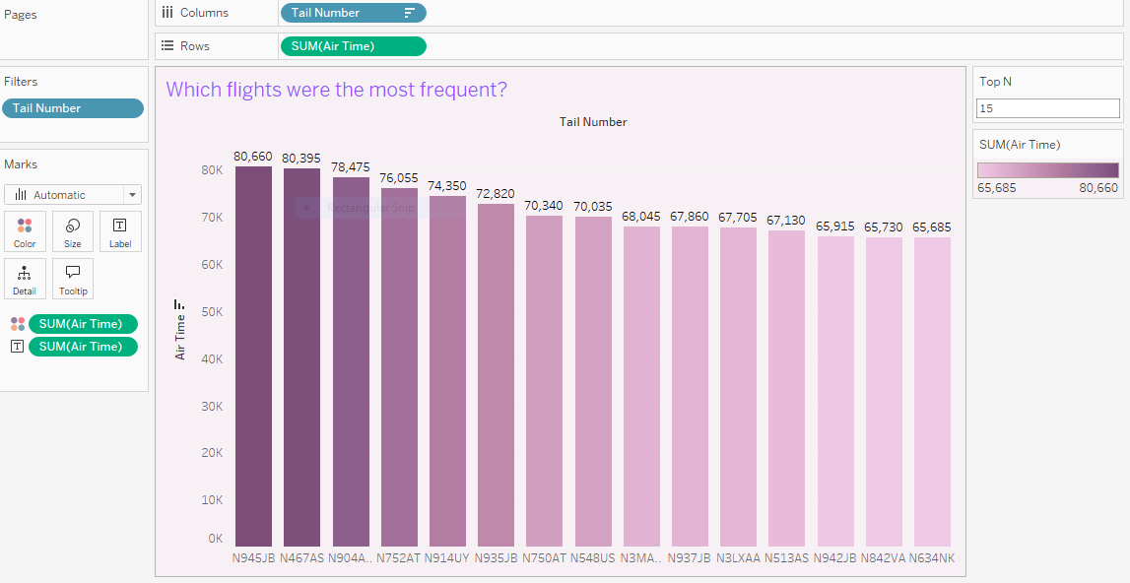
Which are the most flying aircraft in the air?

